Slide 1




PROJECT BOOTCAMP PROGRAM
Olist Store Analysis
Excel | Power BI | SQL | Tableau
Module 1
Module 2
Excel
Power BI
E-Commerce | 5 business KPIs | 4 tools
Module 3
Module 4
TEAM
SQL
Tableau
Pratham Singh, Akash Singh, Pankaj Rajpoot, Nilesh Sunil Chaudari, Pamarthi Venkata Sandeep, Sudha Verma, Saurab Tukaram Jarad
Notes:
Introduce the project: the Olist Store Analysis, an E-Commerce case study. The same five business KPIs were answered in four tools: Excel, Power BI, SQL and Tableau, and the results were cross-checked.

Slide 2






PROJECT
Overview
Domain
E-Commerce
9
99,441
Project Name
Olist Store Analysis
CSV files
orders
Dataset Name
Olist Store Data
Dataset Type
CSV Data
4
5
Dataset Zip Folder Size
45 MB
tools
business KPIs
Tools
Excel, Power BI, SQL, Tableau
Notes:
Domain: E-Commerce. Project name: Olist Store Analysis. The dataset is Olist Store Data: 9 CSV files, about 45 MB zipped, covering 99,441 orders. We used four tools: Excel, Power BI, SQL and Tableau.

Slide 3





PROJECT
KPI's
KPI 1 Weekday Vs Weekend (order_purchase_timestamp) Payment Statistics
KPI 2 Number of Orders with review score 5 and payment type as credit card.
KPI 3 Average number of days taken for order_delivered_customer_date for pet_shop
KPI 4 Average price and payment values from customers of sao paulo city
KPI 5 Relationship between shipping days (order_delivered_customer_date - order_purchase_timestamp) Vs review scores.
Notes:
These are the five KPIs defined for the project. Every module answers the same five questions, so we can compare the results across tools.

Slide 4
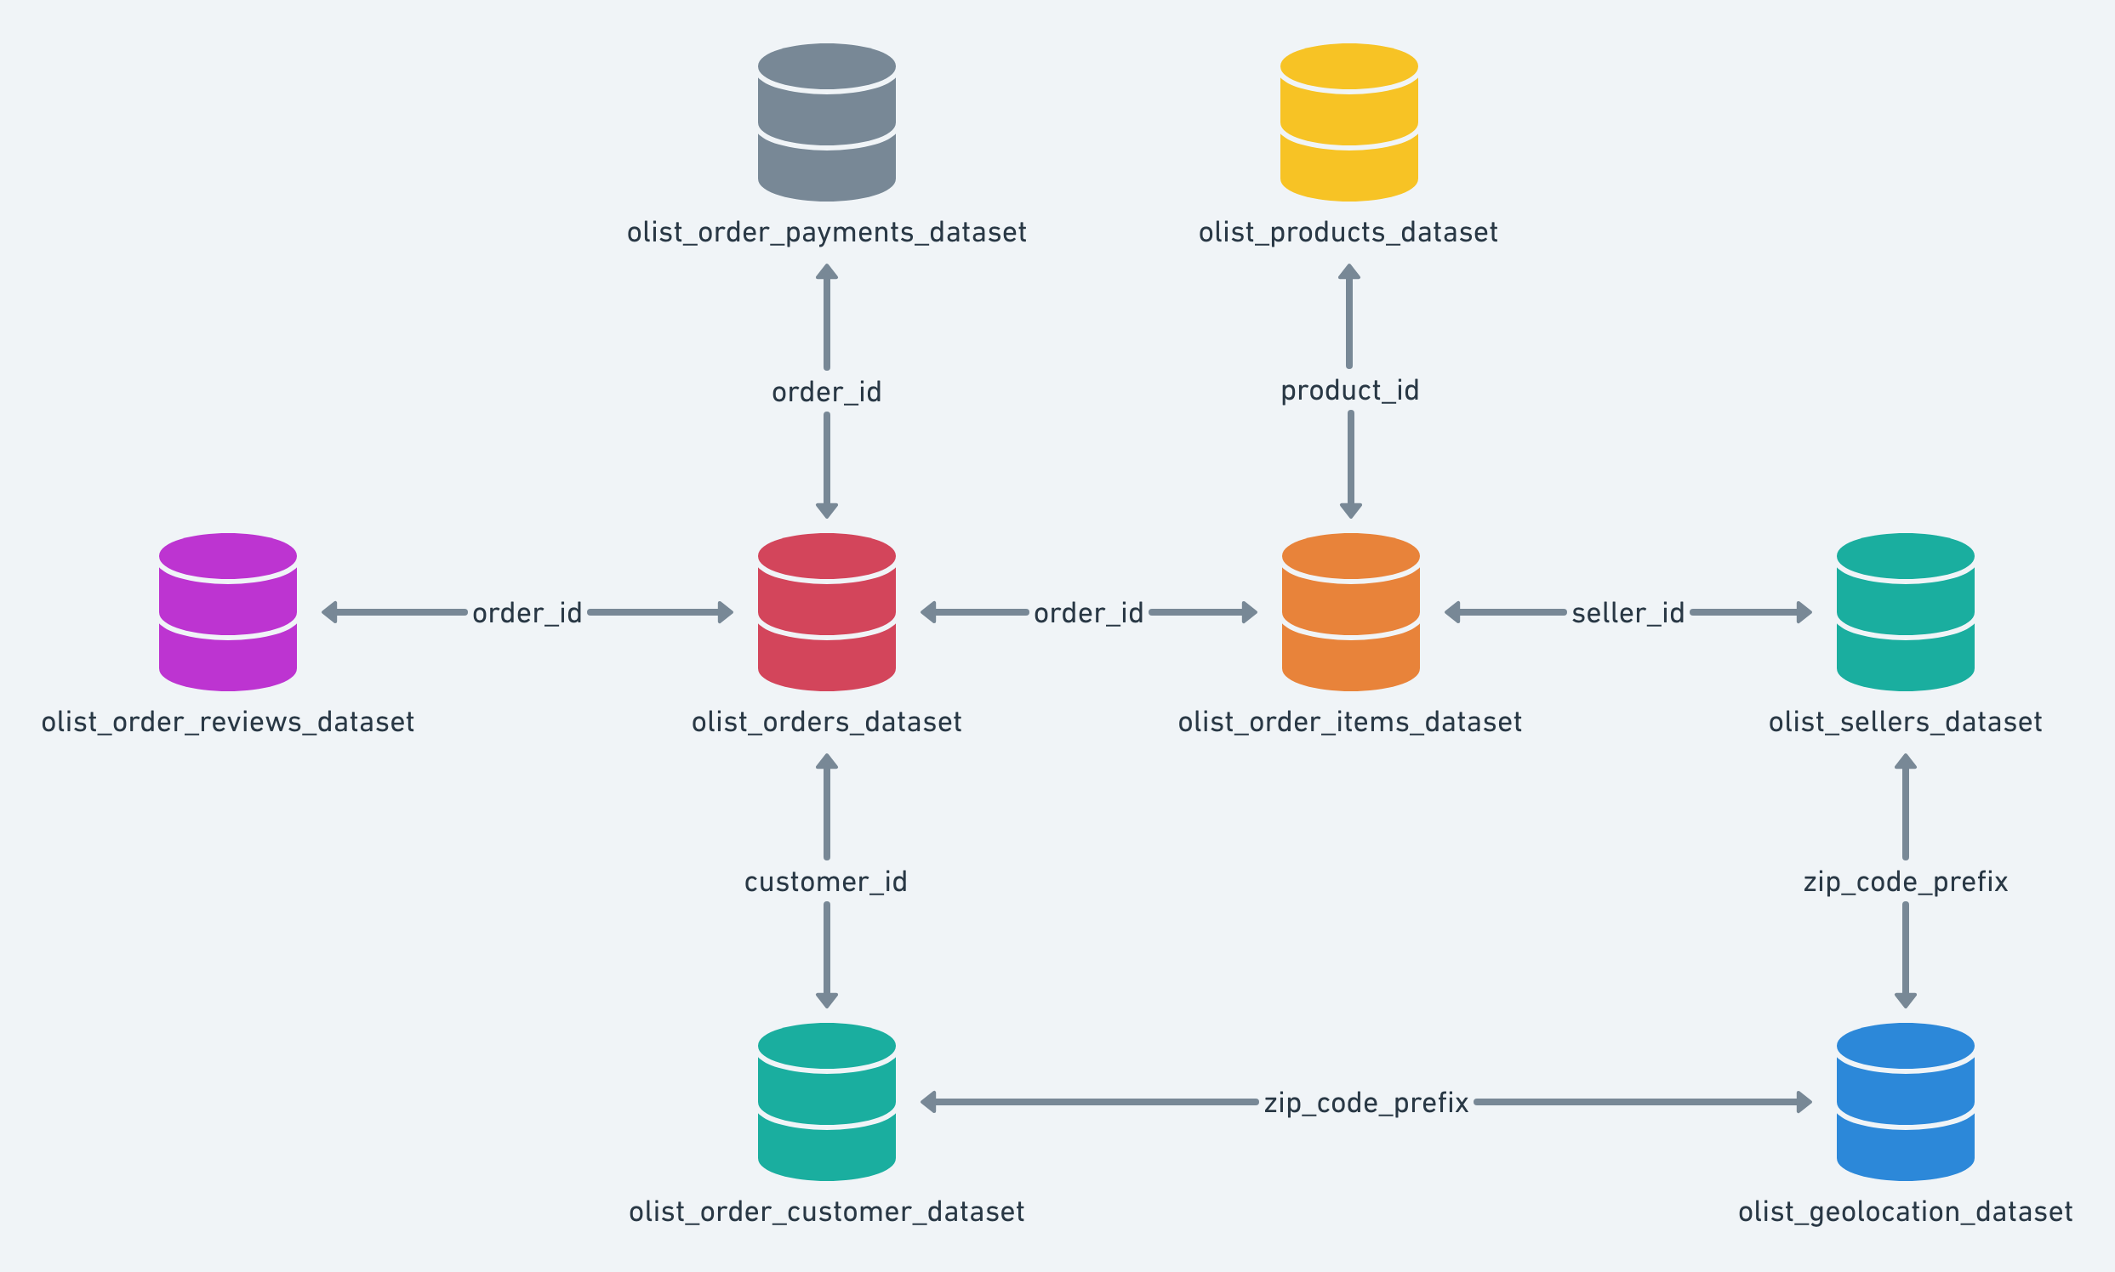
PROJECT
Dataset and Data Model
9
source tables (CSV files)
99,441
orders in the orders table
Joined on order_id, customer_id, product_id, seller_id, zip code prefix and product category name
Geolocation handled through lookup tables built from the raw table
Notes:
This is the data model. The nine tables are connected through order_id, customer_id, product_id, seller_id, the zip code prefix and the product category name. The orders table links to payments, reviews, items and customers. Geolocation has several rows per zip code, so lookup tables were built to keep every relationship valid.

Slide 5
APPROACH
Our Approach: 4 Modules
MODULE 1
MODULE 2
MODULE 3
MODULE 4
Excel
Power BI
SQL
Tableau
Power Query cleaning, Data Model, PivotTables, dashboard
Power Query, relationships, DAX measures, KPI pages and dashboard
MySQL database olist_store, KPI queries
One worksheet per KPI, final dashboard
The same 5 KPIs were answered in every tool and then cross-checked.
Notes:
The project ran in four modules. Excel first, then Power BI, SQL and Tableau. In every module we answered the same five KPIs, then compared the numbers across the tools.

Slide 6
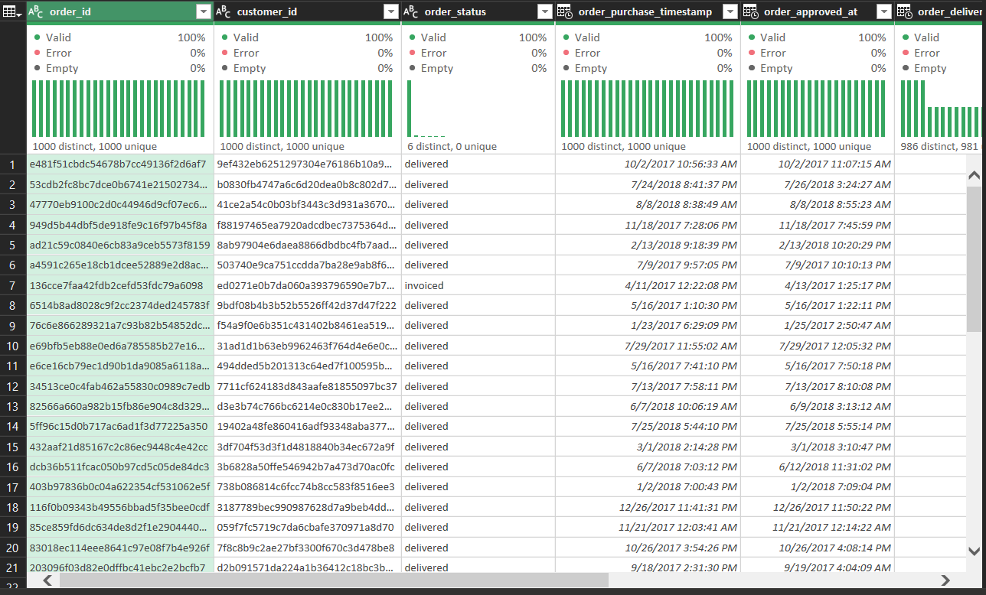
MODULE 1 · EXCEL
Data Cleaning
261,831
duplicate rows removed from the geolocation table
610
products with a blank category set to "unknown"
2,965
undelivered orders kept; excluded only from delivery KPIs
103,886
payment rows for 99,440 orders (installment splits), so orders are counted with a distinct count
Notes:
In Excel we cleaned the data in Power Query. We removed 261,831 duplicate rows from the geolocation table and set 610 blank product categories to unknown. About 2,965 orders have no delivery date because they were never delivered, so we kept them and excluded them only from the delivery KPIs. The payments table has more rows than orders because of installment splits, so we count orders with a distinct count.

Slide 7
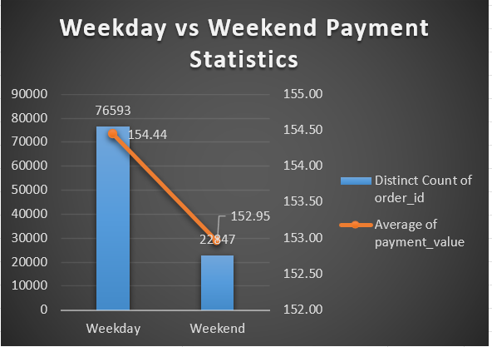
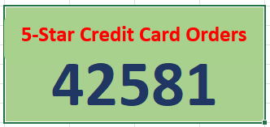
MODULE 1 · EXCEL
KPI 1 and KPI 2
KPI 1: Weekday Vs Weekend Payment Statistics
KPI 2: Orders with review score 5 and credit card
76,593
22,847
43,981
The Excel sheet shows 42,581 (faulty lookup). The distinct-order count in SQL, Power BI and Tableau gives 43,981.
Weekday orders (77.02%), average payment ₹154.44
Weekend orders (22.98%), average payment ₹152.95
orders with review score 5 paid by credit card
Weekend volume is about 3.4x lower, but the average payment barely changes.
Credit card is the dominant payment type among 5-star orders.
Notes:
KPI 1: here we can see the PivotTable with a distinct count of orders and the average payment by day type. Weekdays have 76,593 orders, 77.02 percent of the total, with an average payment of 154.44 rupees. Weekends have 22,847 orders with an average payment of 152.95 rupees. Volume drops sharply at the weekend, but order value barely moves. KPI 2: the verified result is 43,981 orders with review score 5 paid by credit card. The Excel sheet itself still shows 42,581 because of a faulty lookup; the distinct-order count in SQL, Power BI and Tableau gives 43,981.

Slide 8
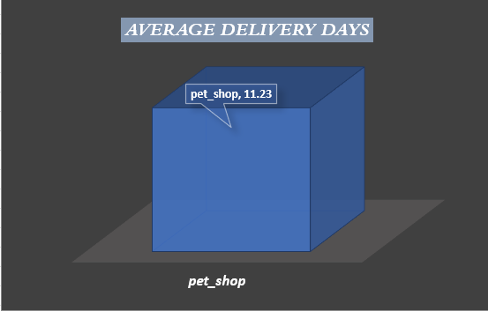
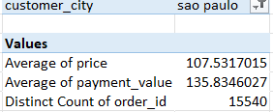
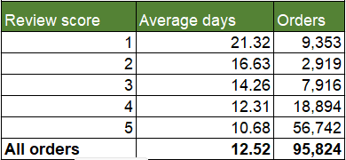
MODULE 1 · EXCEL
KPI 3, KPI 4 and KPI 5
KPI 3: Average days taken for delivery, pet_shop
KPI 4: Average price and payment values, sao paulo city
KPI 5: Shipping days Vs review scores
11.23 days
₹107.53
₹135.83
−0.334
21.32 → 10.68
average delivery time, pet_shop
average price
average payment value
correlation
avg days, score 1 → 5
Pet shop orders take about 11 days to reach the customer.
15,540 orders, about 15.6% of all 99,441 orders.
Longer delivery goes with lower review scores.
Notes:
KPI 3: pet_shop orders take 11.23 days on average from purchase to delivery, using delivered orders only. KPI 4: customers from sao paulo city have an average price of 107.53 rupees and an average payment value of 135.83 rupees across 15,540 orders, about 15.6 percent of all orders. KPI 5: average shipping days fall from 21.32 days for 1-star reviews to 10.68 days for 5-star reviews. The correlation is minus 0.334, so longer delivery means lower ratings.

Slide 9
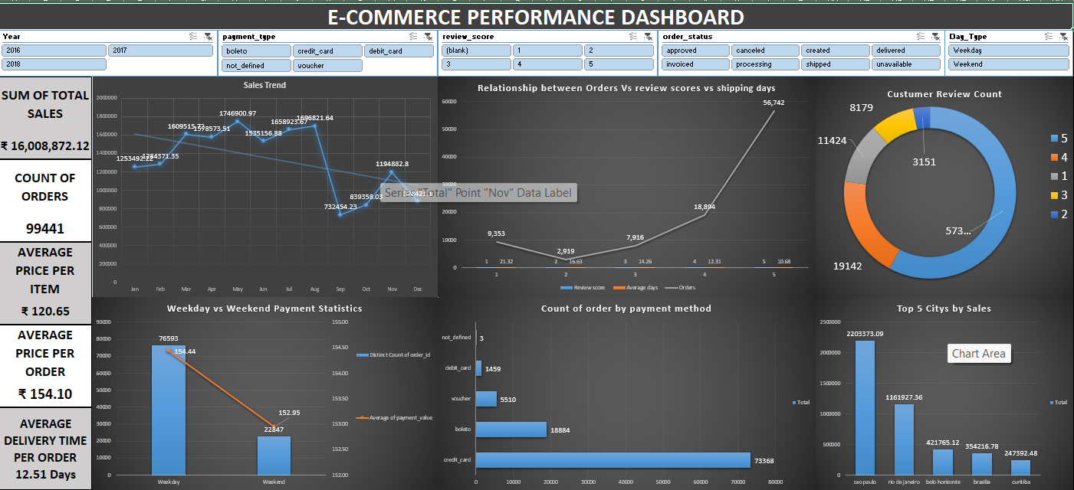
MODULE 1 · EXCEL
Final Dashboard
E-Commerce Performance Dashboard: slicers for year, payment type, review score, order status and day type
Notes:
This is the Excel dashboard that combines the five KPI visuals with extra charts, scorecards and slicers for year, payment type, review score, order status and day type. Walk through the KPI visuals first, then show how the slicers filter the dashboard.

Slide 10
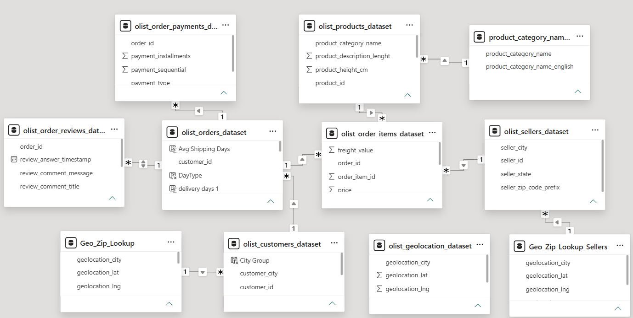
MODULE 2 · POWER BI
Data Model
9
CSV files imported with Power Query
7 + 2
core relationships + 2 geo lookup tables
610
blank product categories set to "unknown"
Built independently of the SQL database: fresh CSV import.
Notes:
The Power BI model was built from a fresh import of the nine CSV files, independent of the SQL database. Seven core relationships were detected automatically. Two separate geolocation lookup tables, one for customers and one for sellers, avoid ambiguous filter paths. The 610 blank product categories were set to unknown, which matches the SQL result.

Slide 11
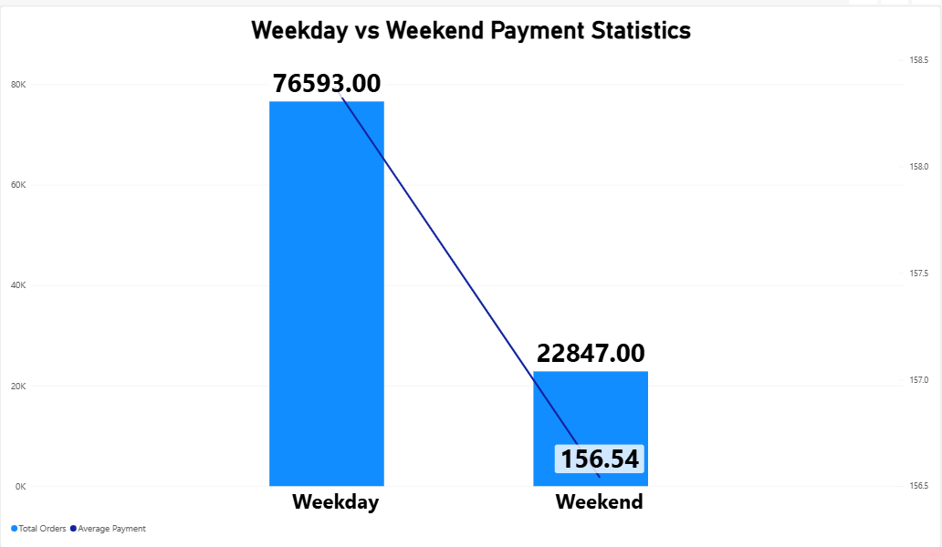
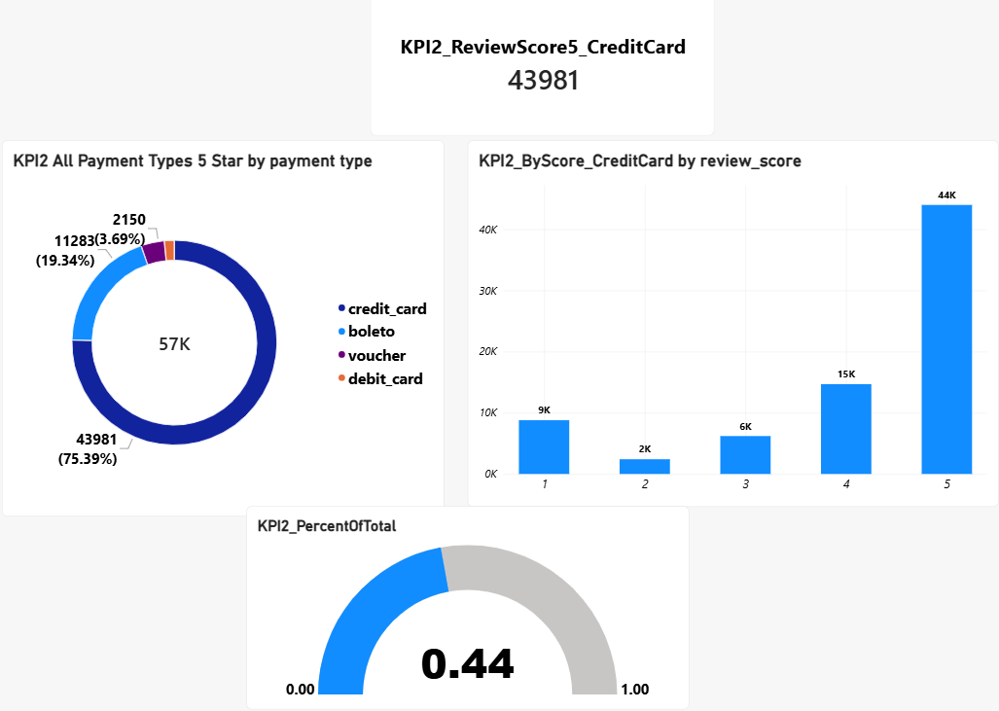
MODULE 2 · POWER BI
KPI 1 and KPI 2
KPI 1: Weekday Vs Weekend Payment Statistics
KPI 2: Orders with review score 5 and credit card
76,593
22,847
43,981
75.4%
Weekday orders (77.02%), average payment ₹154.44
Weekend orders (22.98%), average payment ₹152.95
5-star orders paid by credit card
of all 5-star orders use a credit card
Same result as Excel: weekday volume is far higher, average payment is almost equal.
About 44% of all orders are both 5-star and credit card.
Notes:
KPI 1: the Power BI cards and combo chart show 76,593 weekday orders and 22,847 weekend orders, with average payments of 154.44 and 152.95 rupees, matching Excel and SQL exactly. KPI 2: the card shows 43,981 orders with a 5-star review paid by credit card. Credit card makes up 75.4 percent of all 5-star orders, and about 44 percent of all orders are both 5-star and credit card.

Slide 12
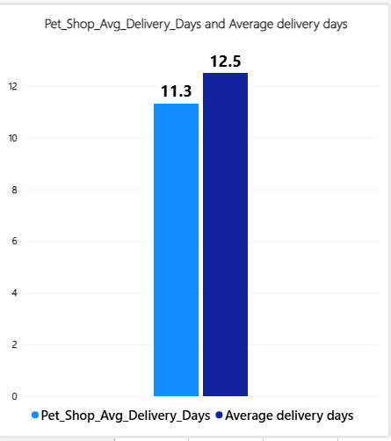
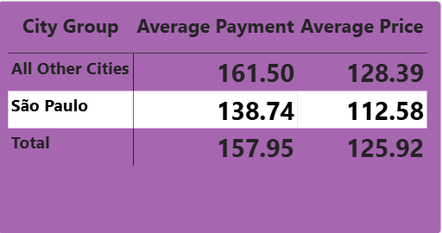
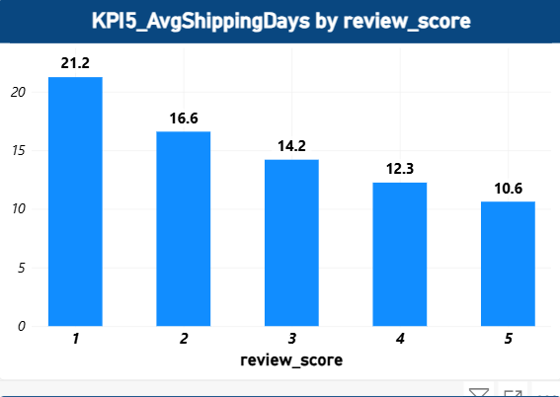
MODULE 2 · POWER BI
KPI 3, KPI 4 and KPI 5
KPI 3: Average days taken for delivery, pet_shop
KPI 4: Average price and payment values, sao paulo city
KPI 5: Shipping days Vs review scores
11.31
12.50
₹112.58
₹138.74
21.25
10.63
pet_shop avg delivery days
overall avg delivery days
average price
average payment value
avg days, score 1
avg days, score 5
Pet shop delivery is slightly faster than the overall average.
Sao Paulo averages are below the platform averages (₹125.92 price, ₹157.95 payment).
Same inverse pattern as Excel: faster delivery, higher score.
Notes:
KPI 3: pet_shop averages 11.31 delivery days against 12.50 days overall. KPI 4: sao paulo customers have an average price of 112.58 rupees and an average payment of 138.74 rupees, below the platform averages of 125.92 and 157.95. This Power BI measure averages per order, so it differs slightly from the Excel row-level average. KPI 5: average shipping days fall from 21.25 days at score 1 to 10.63 days at score 5. The pattern is the same as in Excel.

Slide 13
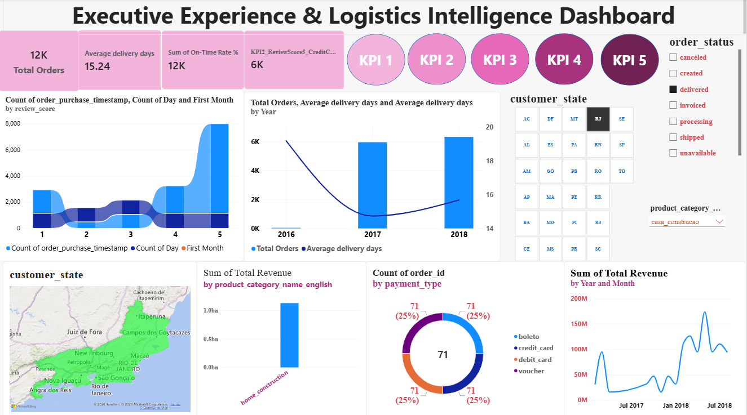
MODULE 2 · POWER BI
Final Dashboard
Power BI dashboard combining the KPI 1 to KPI 5 visuals
Notes:
This is the final Power BI dashboard page. It brings the KPI summary cards, the supporting visuals and the slicers together, with navigation buttons to the KPI 1 to KPI 5 pages.

Slide 14
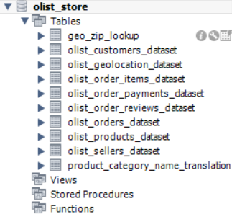
MODULE 3 · SQL
Database Setup
10
tables in the olist_store schema: 9 source tables + geo_zip_lookup
9 of 9
CSV files loaded, row counts verified against the source
Primary and foreign keys defined across the tables
Exported as one self-contained .sql file for the team
Notes:
The SQL database is MySQL, schema olist_store. It has ten tables: the nine source tables plus a deduplicated geo_zip_lookup table. All nine CSV files were loaded and the row counts were checked against the source. Foreign keys connect the tables, and the whole database was exported as a single self-contained SQL file for the team.

Slide 15
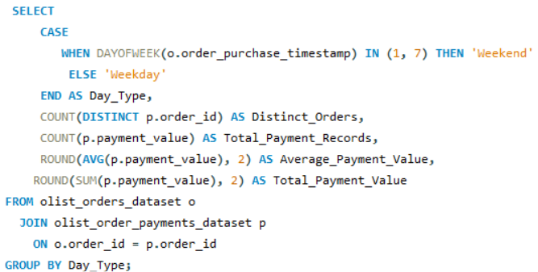
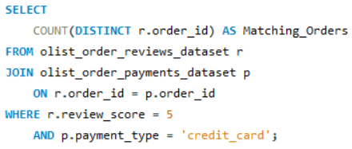
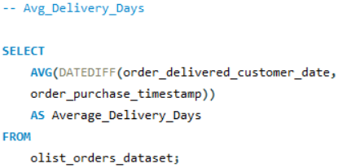
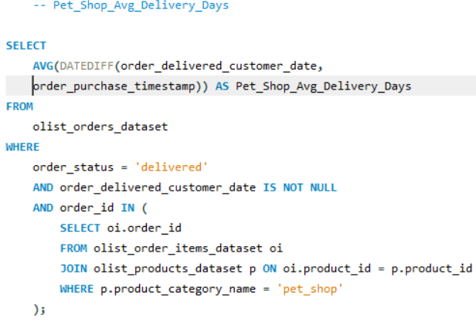
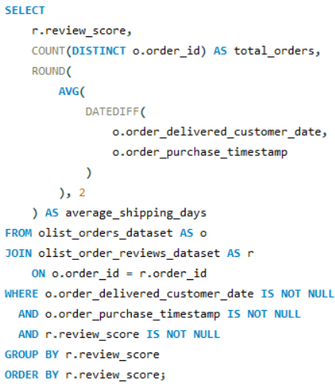
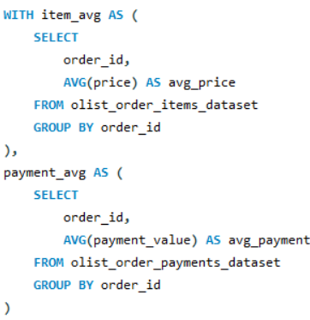
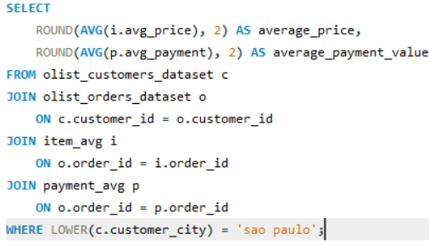
MODULE 3 · SQL
KPI Queries
KPI 1: Weekday Vs Weekend
KPI 2: Score 5 and credit card
KPI 3: pet_shop delivery days
KPI 5: Shipping days Vs review scores
KPI 4: sao paulo price and payment
Notes:
Each block is the SQL output for one KPI. KPI 1: 76,593 weekday and 22,847 weekend orders. KPI 2: 43,981 orders. KPI 3: 11.31 days for pet_shop and 12.50 days overall. KPI 4: average price 112.58 rupees and average payment 138.74 rupees. KPI 5: shipping days fall from 21.25 at score 1 to 10.63 at score 5. All of these match Power BI.

Slide 16



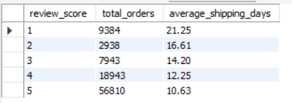
MODULE 3 · SQL
KPI Query Outputs
KPI 1: Weekday Vs Weekend
KPI 2: Score 5 and credit card
KPI 3: pet_shop delivery days
Weekday 76,593 and weekend 22,847 orders
43,981 orders
pet_shop 11.31 days, overall 12.50 days
KPI 4: sao paulo price and payment
KPI 5: Shipping days Vs review scores
Average price ₹112.58, average payment ₹138.74
21.25 days at score 1 down to 10.63 days at score 5
Notes:
Each block is the SQL output for one KPI. KPI 1: 76,593 weekday and 22,847 weekend orders. KPI 2: 43,981 orders. KPI 3: 11.31 days for pet_shop and 12.50 days overall. KPI 4: average price 112.58 rupees and average payment 138.74 rupees. KPI 5: shipping days fall from 21.25 at score 1 to 10.63 at score 5. All of these match Power BI.

Slide 17
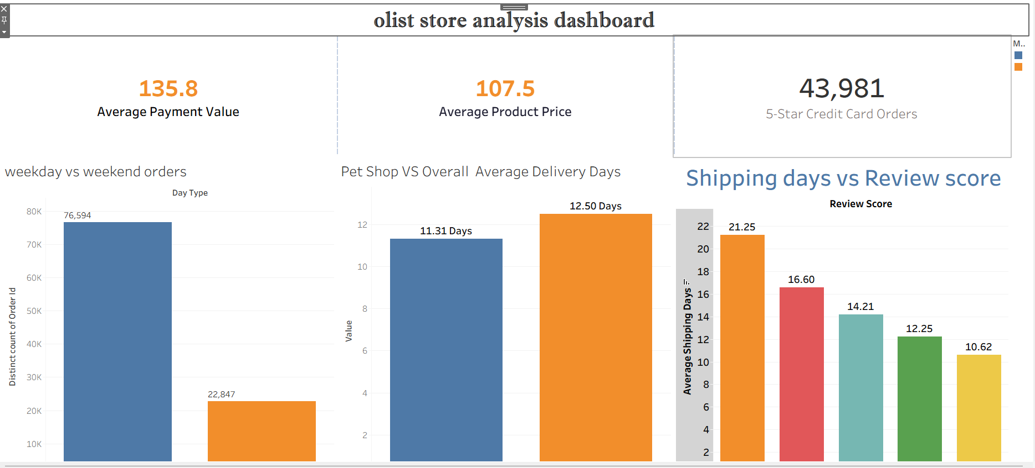
MODULE 4 · TABLEAU
Final Dashboard
All five KPIs combined in one Tableau dashboard
Notes:
This is the final Tableau dashboard, which combines the worksheets for all five KPIs on one page.

Slide 18
COMPARISON
Cross-Tool Comparison
KPI | Excel | Power BI | SQL | Tableau
KPI 1: weekday / weekend orders | 76,593 / 22,847 | 76,593 / 22,847 | 76,593 / 22,847 | 76,594 / 22,847
KPI 1: average payment | ₹154.44 / ₹152.95 | ₹154.44 / ₹152.95 | ₹154.44 / ₹152.95 | ₹154.44 / ₹152.95
KPI 2: 5-star credit card orders | 42,581* | 43,981 | 43,981 | 43,981
KPI 3: pet_shop avg delivery days | 11.23 | 11.31 | 11.31 | 11.31
KPI 4: average price | ₹107.53 | ₹112.58 | ₹112.58 | ₹107.5
KPI 4: average payment | ₹135.83 | ₹138.74 | ₹138.74 | ₹135.8
KPI 5: avg days, score 1 → 5 | 21.32 → 10.68 | 21.25 → 10.63 | 21.25 → 10.63 | 21.25 → 10.62
Highlighted cells differ from the other tools.
* Excel sheet value came from a faulty lookup; 43,981 distinct orders is the verified figure. KPI 5: Excel uses fractional days; SQL, Power BI and Tableau count whole calendar days. KPI 3: Excel 11.23 vs 11.31 in the other three tools. KPI 4: Excel and Tableau use a row-level average; SQL and Power BI average per order.
Notes:
This table compares the results across the four tools. KPI 1, KPI 3 and KPI 5 agree closely. KPI 2 is 43,981 in Power BI, SQL and Tableau; the Excel sheet shows 42,581 because of a faulty lookup. KPI 4 differs by method: Excel and Tableau use a row-level average, while SQL and Power BI average per order. KPI 5 differs slightly because Excel uses fractional days and the other tools count whole calendar days. KPI 3 is 11.23 in Excel and 11.31 in the other three tools.

Slide 19
FINDINGS
Key Findings and Business Meaning
21.32 → 10.68 days
77.02% of orders
Delivery speed drives ratings
Weekdays drive volume
1-star orders average 21.32 days to deliver, 5-star orders 10.68 days (correlation −0.334).
Placed on weekdays; the average payment is almost the same at the weekend (₹154.44 vs ₹152.95).
Business meaning: Set a delivery target (for example under 14 days) and monitor orders that exceed it.
Business meaning: Focus ad spend and logistics on weekdays; test weekend-only offers.
43,981 orders
15,540 orders
Credit card leads among happy customers
Sao Paulo is a key market
5-star and paid by credit card, 75.4% of all 5-star orders.
About 15.6% of all orders; average price ₹107.53 vs ₹120.65 platform average.
Business meaning: Prioritize credit card checkout reliability.
Business meaning: Prioritize Sao Paulo in regional logistics and marketing.
Notes:
Four findings. First, delivery speed drives ratings: 1-star orders average 21.32 days, 5-star orders 10.68 days. Second, weekdays carry 77 percent of orders, while the average payment is nearly the same on weekends. Third, credit card is the dominant payment type among 5-star orders at 75.4 percent. Fourth, Sao Paulo accounts for about 15.6 percent of orders, so it is a key market for logistics and marketing.

Slide 20


LEARNINGS
Challenges and Learnings
Data
Tools
Team
Payments have 103,886 rows for 99,440 orders, so we count distinct orders
2,965 undelivered orders are excluded only from delivery KPIs
Geolocation has duplicate zip rows, handled with lookup tables
The same KPI gives small gaps across tools
Causes include fractional vs whole-day counting and row-level vs per-order averages
KPI 2 in Excel was corrected using distinct orders
One shared clean data foundation for everyone
One owner per KPI
Every KPI was checked before sign-off
Notes:
Main challenges. Data: the payments table has more rows than orders, undelivered orders have blank delivery dates, and the geolocation table has duplicates. Tools: the same KPI gave small gaps across tools because of whole-day versus fractional counting and different averaging methods, and the Excel KPI 2 figure was corrected using distinct orders. Team: a shared clean foundation, one owner per KPI and a check of each KPI before sign-off.

Slide 21
Thank You
Questions and Discussion
Pratham Singh | Akash Singh | Pankaj Rajpoot | Nilesh Sunil Chaudari | Pamarthi Venkata Sandeep | Sudha Verma | Saurab Tukaram Jarad

